Slide 1
Sustainability Living Dashboard Analysis
A Data-Driven Approach Using Power BI
Presented by: Pragathi Venkatesan

Slide 2
Problem Statement
The need for sustainable living practices is growing, but understanding consumer behavior in energy consumption, waste disposal, and sustainable habits remains a challenge.
This project aims to analyze sustainability practices using Power BI visualization techniques.

Slide 3
Dataset Overview
Dataset Name: Sustainable Living Data
Number of Rows: 125k
Number of Columns: 15+
Key Fields:
- Demographics: Age, Gender, Location, Home Type
- Consumption Data: Monthly Electricity & Water Usage
- Sustainability Factors: Transportation Mode, Diet Type, Waste Disposal Methods, Energy Source

Slide 4
Data Cleaning and Preparation
Techniques Used:
- Data Transformation in Power BI
- Created calculated columns for energy and water consumption categories
- Super Query Techniques: IF conditions, GROUP BY, and aggregations
- DAX Formulas: SUM, COUNT, AVERAGE, CALCULATE, FILTER

Slide 5
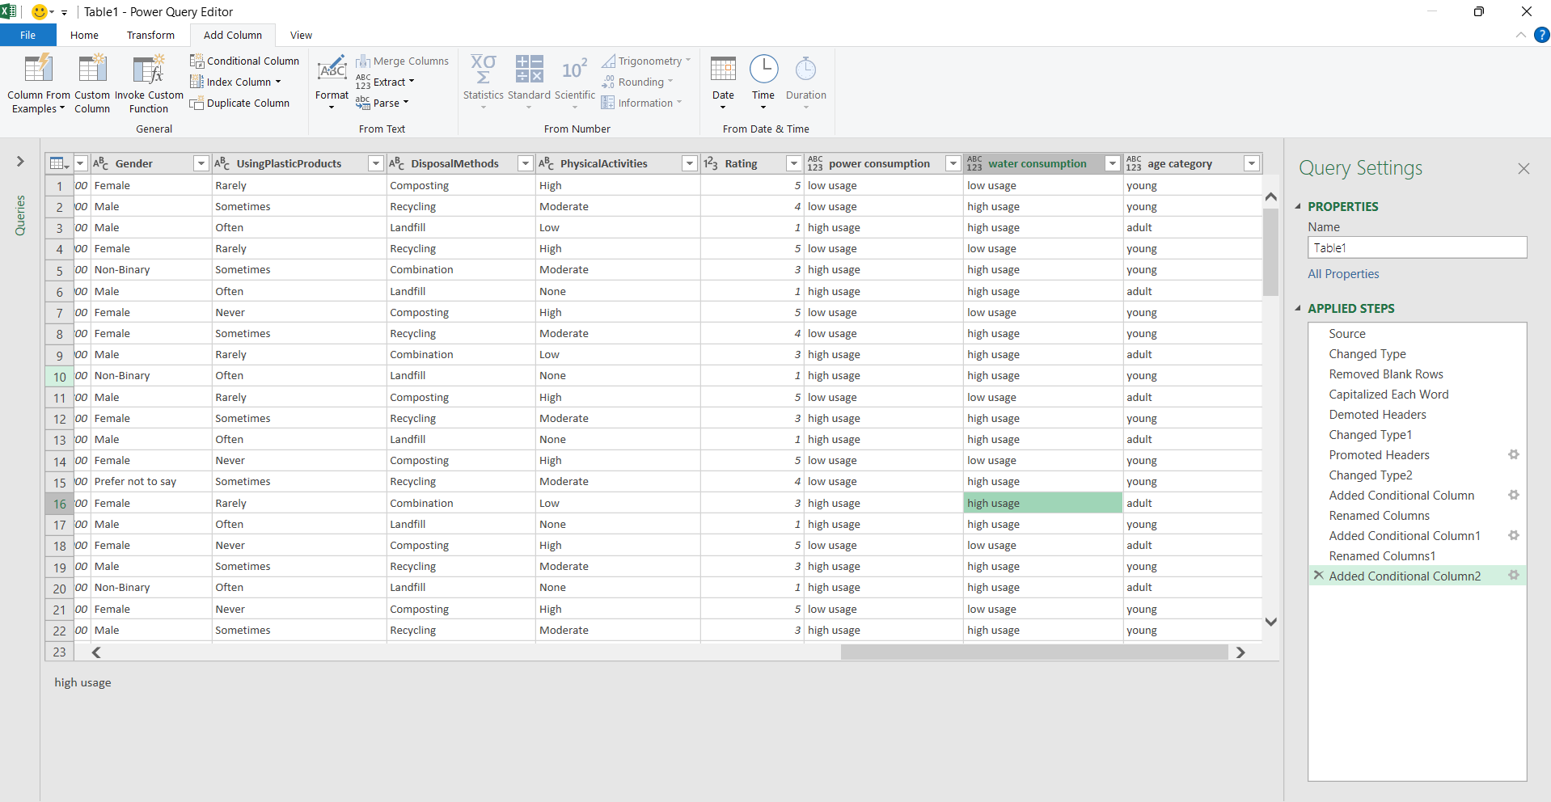

Slide 6
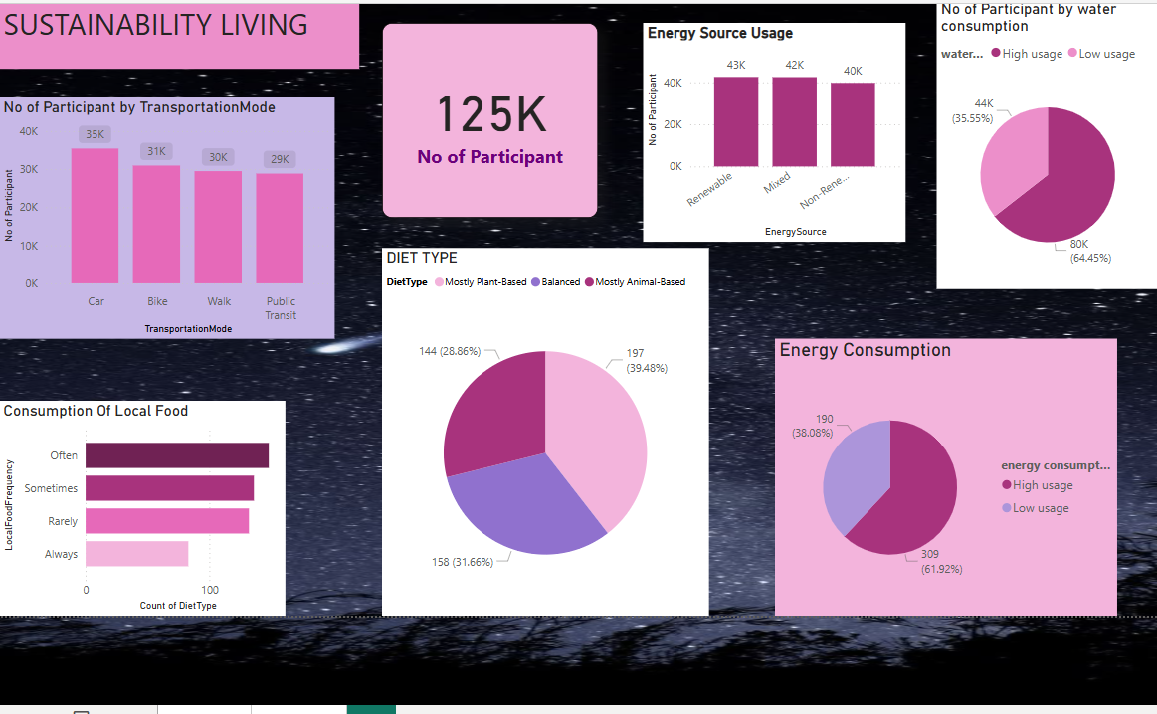

Slide 7
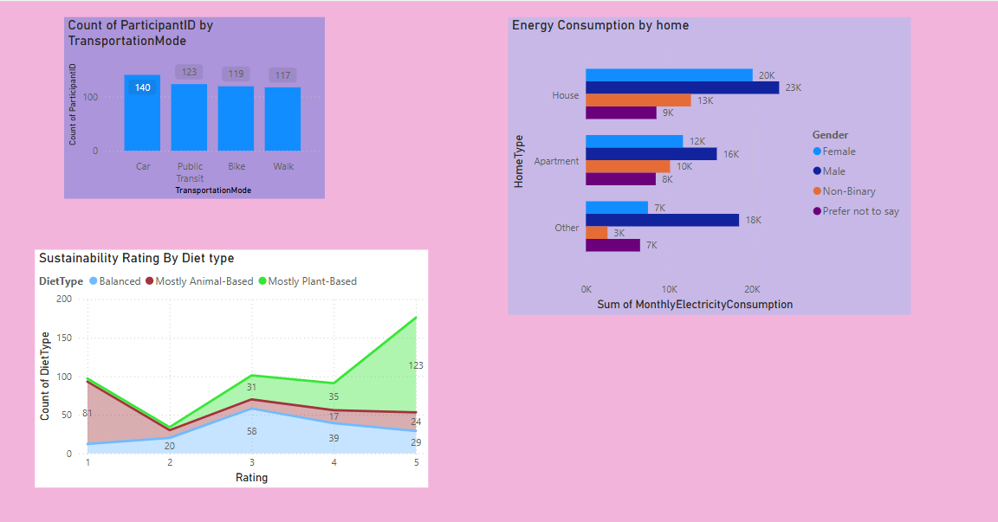

Slide 8
Conclusion & Insights
- Most participants use non-renewable energy, indicating room for better renewable adoption.
- Water consumption habits are mostly sustainable, showing environmental awareness.
- Electricity consumption is higher in houses, suggesting potential savings in energy-efficient homes.
- Diet type impacts sustainability ratings, with plant-based diets scoring higher in sustainability.

